Slide 1




Slide 2

TEST TIME ON EUCLID’S ALGORITHM
URL:
QR CODE:
https://forms.gle/2Qag3HhHTrpx5fna8

Slide 3

KARATSUBA ALGORITHM

Slide 4
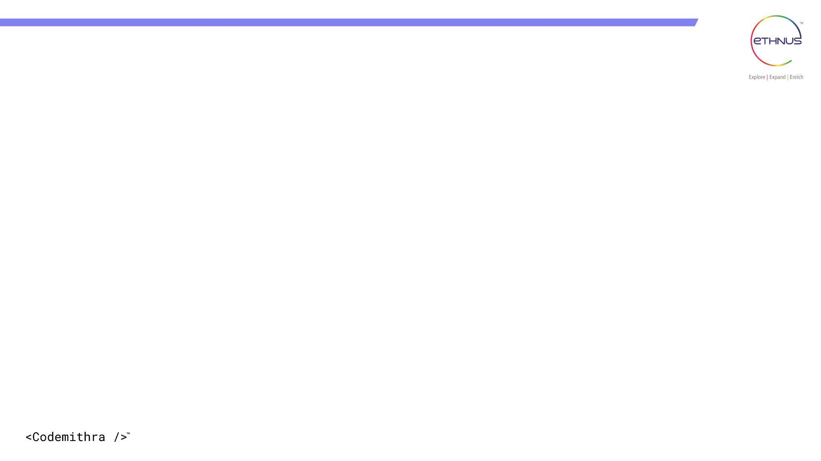

TOPICS
Introduction
Naïve method
Algorithm Explanation
Complexity Analysis
Algorithm
Coding
Interview preparation

Slide 5
KARATSUBA ALGORITHM
INTRODUCTION
The Karatsuba algorithm is a fast multiplication algorithm. It was discovered by Anatoly Karatsuba in 1960 and published in 1962.
A fast multiplication algorithm uses a divide and conquer approach to multiply two numbers.
The naive algorithm for multiplying 2 numbers has a running time of O(n²), where karatsuba algorithm has a runtime of

Slide 6
INTRODUCTION
Being able to multiply numbers quickly is very important. Computer scientists often consider multiplication to be a constant time ~ O(1) operation which is reasonable for small numbers.
Whereas for larger numbers, the actual running times need to be factored in, which is O(n²)

Slide 7
NAIVE METHOD
The naive method is to follow the elementary school multiplication method, i.e. to multiply each digit of the second number with every digit of the first number and then add all the multiplication results.
This algorithm takes O(n²) time.

Slide 8
NAIVE METHOD
public static int multiplication(int X, int Y) { // Convert numbers into string String x = Integer.toString(X); String y = Integer.toString(Y); int result = 0; // Looping over y for (int i = 0; i < y.length(); i++) { int carry = 0; // intermediate carry String inter_res = ""; // intermediate result // Looping over x. for (int j = x.length() - 1; j >= 0; j--) { // intermediate multiplication of each digit and addition of carry. int num = Character.getNumericValue(y.charAt(i)) * Character.getNumericValue(x.charAt(j)) + carry; if (num > 9 && j > 0) { inter_res = Integer.toString(num % 10) + inter_res; | carry = num / 10; } // else the digit is append to the intermediate result // And assign carry as zero else { inter_res = Integer.toString(num) + inter_res; carry = 0; } } // Adding the intermediate results result *= 10; result += Integer.parseInt(inter_res); } System.out.print("result: "); return result; }}

Slide 9
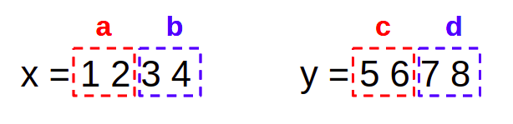
KARATSUBA ALGORITHM
Let’s consider two 4-digit numbers x and y where x=1234 and y=5678.
First of all, we should divide the n-digit numbers into n/2-digit numbers as shown below.
a and c represent the first n/2 digits of x and y. Similarly, b and d represent the last n/2 digits of x and y

Slide 10
The Karatsuba algorithm involves 4 main steps
Step 1: Compute a.c = 12 x 56 = 672
Step 2: Compute b.d = 34 x 78 = 2652
Step 3: Compute (a+b)(c+d) = 46 x 134 = 6164
Step 4: Compute (3)-(2)-(1)=6164-2652-672 = 2840
Finally, multiply the output of step 1 by 10^{n}, the output of step 4 by 10^{n/2}, and add them both with the output of step 2.
6720000 + 284000 + 2652 = 7006652

Slide 11
To multiply X = 1234 and Y = 2345 using the Karatsuba algorithm
a
b
c
d
Y =
23 | 45
12 | 34
X =
Steps:
Step 1: Compute a.c = 12 x 23 = 276
Step 2: Compute b.d = 34 x 45 = 1530
Step 3: Compute (a+b)(c+d) = 46 x 68 = 3128
Step 4: Compute (3) - (2) - (1) = 3128 - 1530 - 276 = 1322
Finally, multiply the output of step 1 by 10000 (10⁴), the output of step 4 by 100 (10²), and add them both with the output of step 2.
Result: 2760000 + 132200 + 1530 = 2893730
The product of 1234 and 2345 using the Karatsuba algorithm is 2897730.

Slide 12
compute the product of 23 and 67 using the Karatsuba algorithm.
a
b
c
d
Y =
2 | 3
6 | 7
X =
Step 1: Compute a.c = 2 x 6 = 12
Step 2: Compute b.d = 3 x 7 = 21
Step 3: Compute (a+b)(c+d) = (2+3)(6+7) = 5 x 13 = 65
Step 4: Compute (3) - (2) - (1) = 65 - 21 - 12 = 32
Finally, multiply the output of Step 1 by 10^n (where n is the number of digits), the output of Step 4 by 10^n/2, and add them both with the output of Step 2.
1200 + 320 + 21 = 1541
product of 23 and 67 using the Karatsuba algorithm is 1541.

Slide 13

TIME COMPLEXITY
Assuming that we replace two of the multiplications with only one makes the program faster.
Karatsuba improves the multiplication process by replacing the initial complexity from quadratic to
Where n is the number of digits of the numbers multiplying.
The Time Complexity of the algorithm can be represented as follows

Slide 14
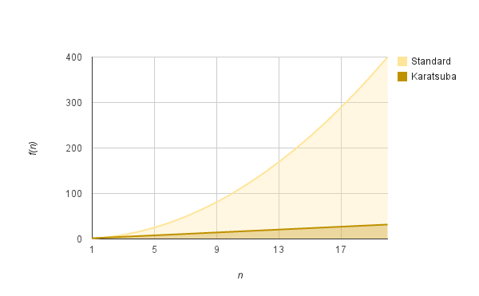
TIME COMPLEXITY

Slide 15
IMPLEMENTATION
ALGORITHM
Compute starting set (a*c)
Compute set after starting set may it be ending set (b*d)
Compute starting set with ending sets (a+b)(c+d)
Subtract values of Step 3 from Step 2 from Step 1
Add all the values with the following modifications:-
Pad up 10^{n} to the number obtained from Step 1
Step 2 value unchanged
Pad up 10^{n/2} to the value obtained from Step 4.

Slide 16
Program
Input
enter number1-12
enter number2-12
output
12 * 12 = 144

Slide 17
import java.util.*; public class Main { public static int karatsuba(int x, int y) { if (x < 10 || y < 10) { return x * y; } int m = Math.max(getNumDigits(x), getNumDigits(y)); int halfM = m / 2; int powerOf10 = (int) Math.pow(10, halfM); int a = x / powerOf10; int b = x % powerOf10; int c = y / powerOf10; int d = y % powerOf10; int ac = karatsuba(a, c); int bd = karatsuba(b, d); int abcd = karatsuba(a + b, c + d); int result = ac * (int) Math.pow(10, 2 * halfM) + (abcd - ac - bd) * powerOf10 + bd; return result; } | private static int getNumDigits(int x) { if (x == 0) { return 1; } int count = 0; while (x > 0) { count++; x /= 10; } return count; } public static void main(String[] args) { Scanner s1=new Scanner(System.in); System.out.print("enter number1-"); int x = s1.nextInt(); System.out.print("enter number2-"); int y = s1.nextInt(); int product = karatsuba(x, y); System.out.println(x + " * " + y + " = " + product); }}
Notes:
enter number1-12
enter number2-12
12 * 12 = 144

Slide 18
import java.math.BigInteger; import java.util.Scanner; public class KaratsubaAlgorithm { public static BigInteger karatsuba(BigInteger x, BigInteger y) { int n = Math.max(x.bitLength(), y.bitLength()); // Base case: if either x or y is small, use standard multiplication if (n <= 2000) { return x.multiply(y); } // Split the numbers into two halves int half = (n + 32) / 64 * 32; // round up to the nearest multiple of 64 bits BigInteger mask = BigInteger.ONE.shiftLeft(half).subtract(BigInteger.ONE); BigInteger xLow = x.and(mask); BigInteger yLow = y.and(mask); BigInteger xHigh = x.shiftRight(half); BigInteger yHigh = y.shiftRight(half); | BigInteger z0 = karatsuba(xLow, yLow); BigInteger z1 = karatsuba(xLow.add(xHigh), yLow.add(yHigh)); BigInteger z2 = karatsuba(xHigh, yHigh); // Combine the results BigInteger result = z2.shiftLeft(2 * half).add(z1.subtract(z2).subtract(z0).shiftLeft(half)).add(z0); return result; } public static void main(String[] args) { Scanner scanner = new Scanner(System.in); System.out.print("Enter the first number: "); BigInteger x = scanner.nextBigInteger(); System.out.print("Enter the second number: "); BigInteger y = scanner.nextBigInteger(); BigInteger product = karatsuba(x, y); System.out.println("Product: " + product); }}
Notes:
Enter the first number: 12
Enter the second number: 12
Product: 144

Slide 19
INTERVIEW QUESTIONS

Slide 20
INTERVIEW QUESTIONS
What is the Karatsuba algorithm?
The Karatsuba algorithm is a fast multiplication algorithm that allows multiplying large integers in a more efficient manner than the traditional multiplication algorithm. It reduces the number of recursive multiplications required by breaking down the numbers into smaller parts.

Slide 21
INTERVIEW QUESTIONS
How does the Karatsuba algorithm work?
The Karatsuba algorithm works by splitting the input numbers into two halves and recursively calculating three products. These three products are combined using some arithmetic operations to obtain the final product.

Slide 22
INTERVIEW QUESTIONS
What are the advantages of the Karatsuba algorithm over traditional multiplication?
The Karatsuba algorithm has a lower time complexity than traditional multiplication algorithms for large numbers. It reduces the number of multiplications required and, therefore, improves the overall efficiency of the multiplication operation.

Slide 23
INTERVIEW QUESTIONS
Can you explain the recursive steps involved in the Karatsuba algorithm?
In the Karatsuba algorithm, the input numbers are split into two halves. Three recursive multiplications are performed: one for the lower halves, one for the sum of the halves, and one for the upper halves. These products are combined using arithmetic operations to obtain the final result.

Slide 24
PRACTICE QUESTIONS
Question 1: Implement a recursive function to compute the product of two large integers using Karatsuba algorithmDescription: Implement a recursive function that uses the Karatsuba algorithm to calculate the product of two large integers represented as strings.
Input: Two strings, `x` and `y`, representing large integers.
Output: A string representing the product of `x` and `y`.
Sample Input:
x = "12345678901234567890"
y = "98765432109876543210"
Sample Output:
12193263111263526900000000000000000000

Slide 25
PRACTICE QUESTIONS
Question 2: Implement the Karatsuba algorithm to multiply two polynomials
Description: Implement the Karatsuba algorithm to multiply two polynomials represented as arrays of coefficients.
Input: Two arrays of integers, `poly1` and `poly2`, representing the coefficients of two polynomials.
Output: An array of integers representing the coefficients of the product polynomial.
Sample Input:
poly1 = [1, 2, 3] // Represents 1 + 2x + 3x^2
poly2 = [4, 5, 6] // Represents 4 + 5x + 6x^2
Sample Output:
[4, 13, 28, 27, 18] // Represents 4 + 13x + 28x^2 + 27x^3 + 18x^4

Slide 26




THANK YOU
+91 78150 95095
codemithra@ethnus.com
www.codemithra.com

